Slide 1
Week 10: Project lab

Slide 2
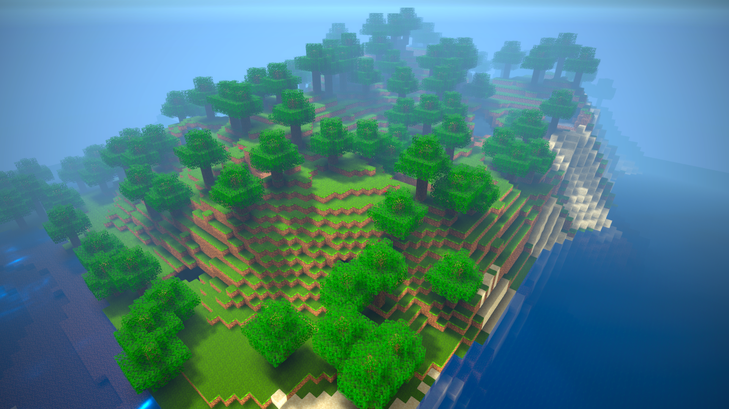
Last class
Chunks and chunk generation

Slide 3
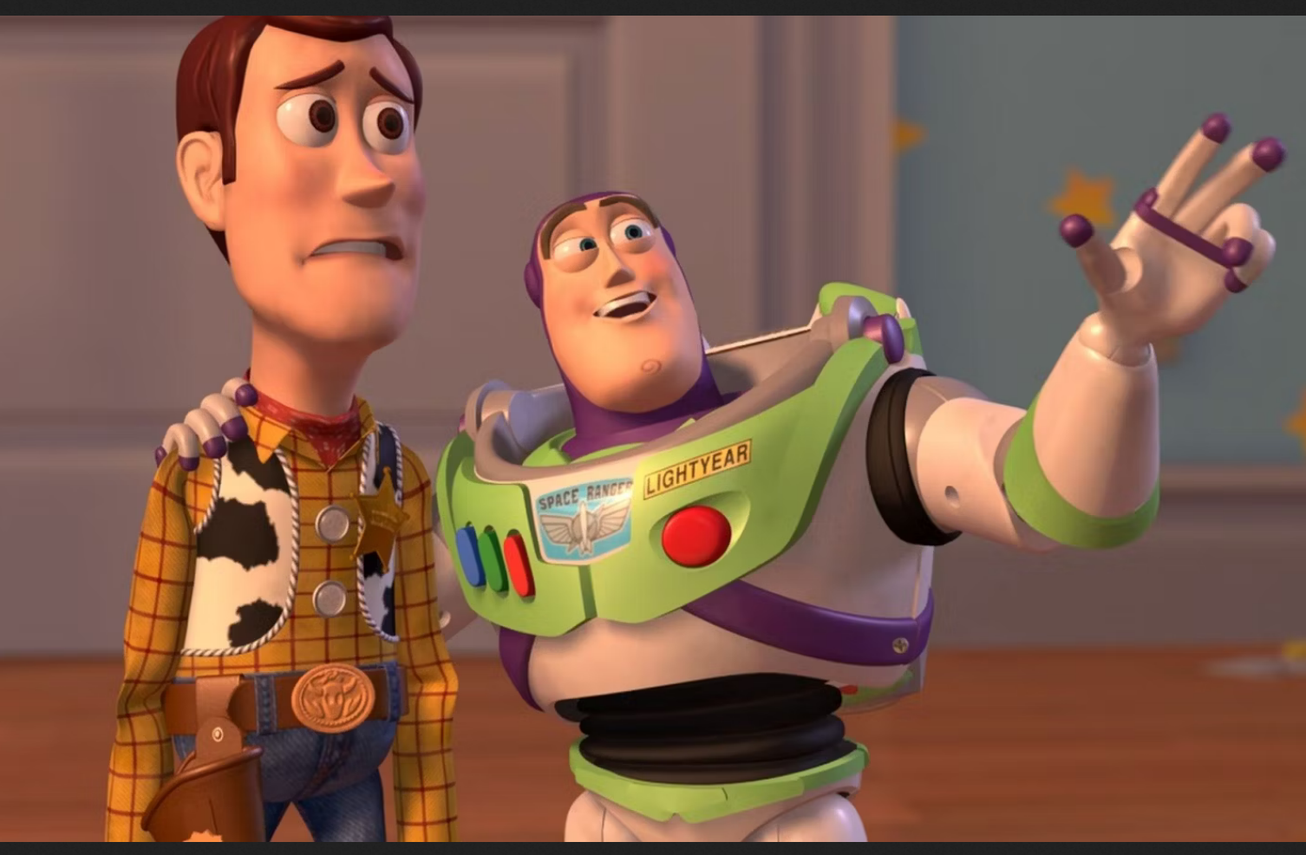
Course schedule
 | Monday | Thursday
Week 1 : 12/02 | Introduction | C#/Unity Lab
Week 2 : 19/02 | 3D reasoning | 3D Lab
Week 3 : 26/02 | Basic Pipeline | Lab
Week 4 : 04/03 | Textures | Normal maps Labs
Week 5 : 11/03 | Post processing | Camera’s Light
Week 6 : 18/03 | Materials | Aliasing Materials Lab
Week 7 : 25/03 | Procedural generation Theory | Procedural generation Practice
Week 8 : 15/04 | Advanced pipeline | Cancelled
Week 9 : 22/04 | Lab 07 explanation | Project explanation
Week 10 : 29/04 | Project explanation 2 | Guest Lecture Project Labs
Week 11 : | Problem solving 101 | Holiday

Slide 4
This class
→ Bureaucracy←
Good news / bad news
Project features
Solving the pupil

Slide 5
Bureaucracy
Deadline is 9th of June 23:59, put it in your calendar
I’m strict on my deadline, please submit at 22:00
submit = push your code
Accept the classroom today and submit the URL on Toledo

Slide 6
This class
Bureaucracy
→ Good news / bad news ←
Project features
Solving the pupil

Slide 7
Good news / bad news
I removed the post processing part of the assignment
Minecraft part is a bit larger now
Apologies for not having hand-on experience with that

Slide 8
This class
Bureaucracy
Good news / bad new
→ Project features ←
Solving the pupil

Slide 9
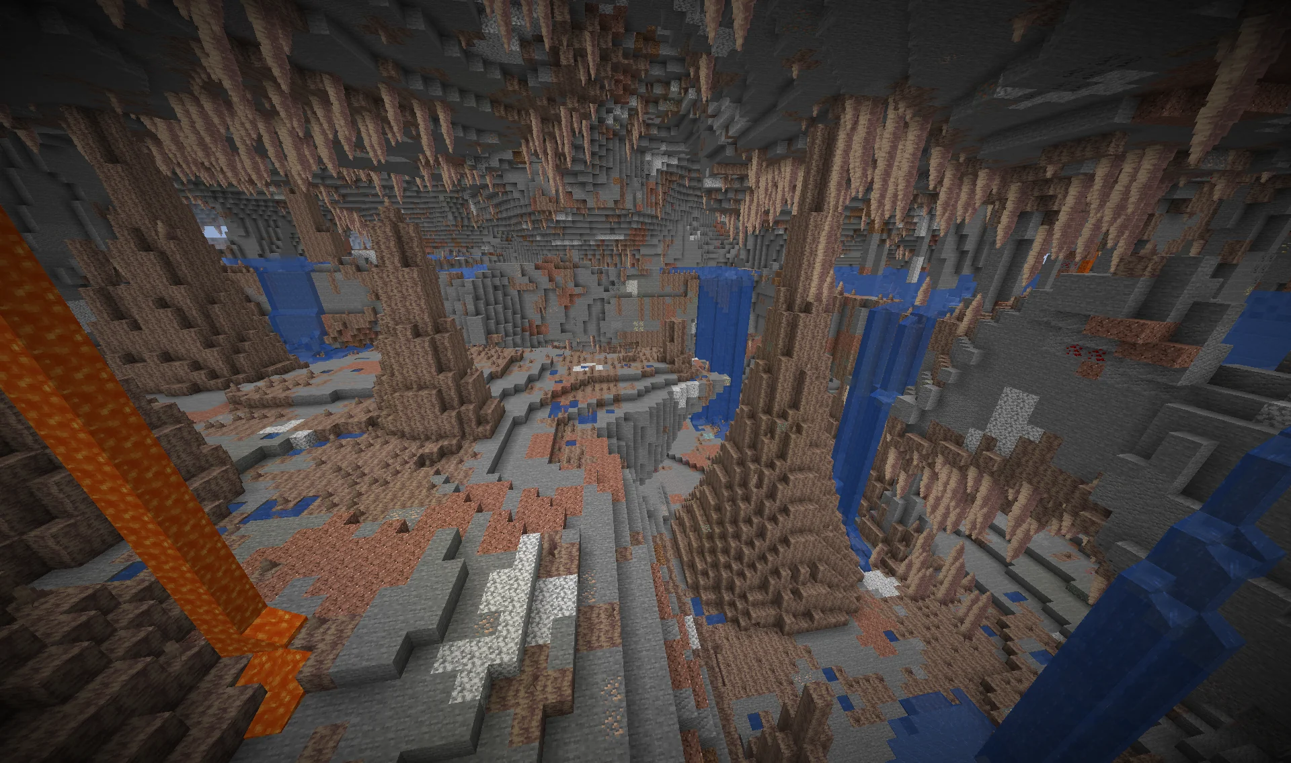
Caves
Do you have an idea on how to solve this?

Slide 10
This class
Bureaucracy
Good news / bad new
Project features
→ Solving the pupil ←

Slide 11
Congrats on the labs
Had a quick look, seems to have gone well
Eye movement seems to be the hardest one
Let’s solve it

Slide 12
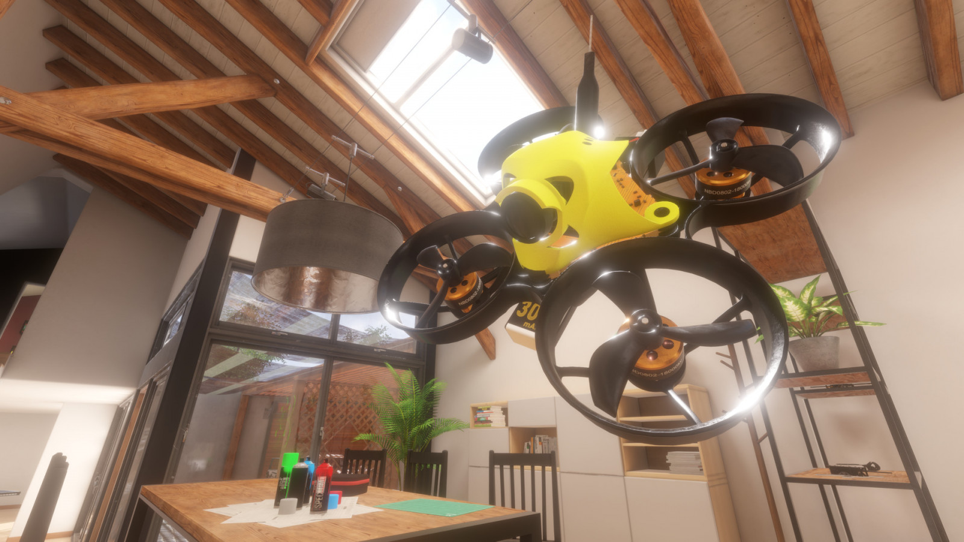
Next class

